Slide 1
APOLOGETICS
IN ONE LESSON
almost
Ai1L.net
Lesson 5
Is the New Testament from Eyewitnesses?

Slide 2
Key Takeaways (review)
1
Remember that you are a foreigner spreading the Gospel in a foreign land (the United States)
2
Look for areas of agreement before looking for areas of disagreement
3
Build a case for the Gospel starting with the areas of agreement

Slide 3
Key Takeaways (review)
1
1 Peter 3:15 (“the Apologist’s verse”) emphasizes character over case-making
2
Representing God’s character matters as much as representing the facts
3
A good ambassador uses an artful method in addition to good facts

Slide 4
Lesson | Why?
The Art of Asking Questions | Use questions to further a conversion
Gardening and Harvesting | Make progress, not a home run
Ambassadors for Christ | Represent Christ in our approach
A-Paul-agetics | Don’t just become a harsh critic

Slide 5
183
307
Questions Jesus
Questions Jesus
Answered
Asked

Slide 6
“If I have only an hour with someone, I will spend the first 55 minutes asking questions and finding out what is troubling their heart and mind, …”
FRANCIS SCHAEFFER

Slide 7
“… and then in the last 5 minutes I will share something of the truth.”
FRANCIS SCHAEFFER

Slide 8

Simon of Cyrene, father of Rufus
1
Mark was written in Rome
Rufus is possibly associated with Rome
2
Mark names Rufus in Mark 15:21
3
Paul acknowledges a Rufus in Romans 16:13
Rufus was named in Mark because he was known to the people in Rome

Slide 9
Sources in the Gospel of Mark
Peter flees (14:72)
Two women named¹ (15:47)
Angel says to get Peter (16:7)
Peter’s perspective
Peter’s perspective
Women’s perspective
Three women named² (16:1)
Jesus criticizes the men for not believing (16:14)
Simon of Cyrene (15:21)
¹ | Mary Magdalene Mary, mother of Joseph
² | Mary Magdalene Mary, mother of James Salome

Slide 10
Τα Βιβλία
People reading the memoirs
Events of Jesus’ Life
People who interviewed eyewitnesses
Eyewitnesses
Matthew & John
Mark & Luke*
* Luke switches to eyewitness testimony in Acts 16:10

Slide 12
IDEA IN BRIEF
What?
Show that the Gospel accounts come from eyewitness testimony
Why?
So that we can show that the Gospels did not form via legendary development
How?
By showing that:
Gospels are ancient biographies which expected living eyewitnesses
The New Testament & early church valued and named living eyewitness sources

Slide 13
Read the requirements for the 12 Apostles
1

Slide 14
“ Therefore it is necessary to choose one of the men who have accompanied us the whole time the Lord Jesus went in and out among us, beginning from John’s baptism until the day Jesus was taken up from us. For one of these must become a witness with us of His resurrection.” So they proposed two men: Joseph called Barsabbas (also known as Justus) and Matthias. ”
Acts 1:21-23

Slide 15
“And they prayed, “Lord, You know everyone’s heart. Show us which of these two You have chosen to take over this ministry and apostleship, which Judas abandoned to go to his rightful place.” Then they cast lots, and the lot fell to Matthias; so he was added to the eleven apostles.”
Acts 1:24-26

Slide 16
“the events had hardly passed out of sight, conscious as I was that I had preserved the true story”
FLAVIUS JOSEPHUS The Life of Flavius Josephus, 361

Slide 17
“I, on the contrary, have written a veracious account, at once comprehensive and detailed, of the war, having been present in person at all the events.”
FLAVIUS JOSEPHUS Against Apion, 1.9

Slide 18
“where some persons have written histories, and published them, without having been in the places concerned, …”
FLAVIUS JOSEPHUS Against Apion, 1.8

Slide 19
“… but these men put a few things together by hearsay, and insolently abuse the world, and call these writings by the name of Histories.”
FLAVIUS JOSEPHUS Against Apion, 1.8

Slide 20
Document the claims that Luke makes in regards to his sources
2

Slide 21
“Many have undertaken to compose an account of the things that have been fulfilled among us, just as they were handed down to us by the initial eyewitnesses and servants of the word.”
Luke 1:1-2

Slide 22
“Therefore, having carefully investigated everything from the beginning, it seemed good also to me to write an orderly account for you, most excellent Theophilus”
Luke 1:3

Slide 23
“so that you may know the certainty of the things you have been taught.”
Luke 1:4

Slide 24
“That which was from the beginning, which we have heard, which we have seen with our own eyes, which we have gazed upon and touched with our own hands—this is the Word of life.”
1 John 1:1

Slide 25
Heirapolis
Home of Papias

Slide 26
“For I did not think that information from the books would profit me as much as information from a living and surviving voice.”
PAPIAS OF HIERAPOLIS Ecclesiastical History 3.39.3-4 Writing ~110 CE of an earlier period (~80 CE)

Slide 27
“I shall not hesitate also to put into ordered form for you, along with the interpretations, everything I learned carefully in the past from the elders and noted down carefully, for the truth of which I vouch.”
PAPIAS OF HIERAPOLIS Ecclesiastical History 3.39.3-4 Writing ~110 CE of an earlier period (~80 CE)

Slide 28
“For unlike most people I took no pleasure in those who told many different stories, but only in those who taught the truth.”
PAPIAS OF HIERAPOLIS Ecclesiastical History 3.39.3-4 Writing ~110 CE of an earlier period (~80 CE)

Slide 29
“Nor did I take pleasure in those who reported their memory of someone else’s commandments …”
PAPIAS OF HIERAPOLIS Ecclesiastical History 3.39.3-4 Writing ~110 CE of an earlier period (~80 CE)

Slide 30
“…but only in those who reported their memory of the commandments given by the Lord to the faith and proceeding from the Truth itself.”
PAPIAS OF HIERAPOLIS Ecclesiastical History 3.39.3-4 Writing ~110 CE of an earlier period (~80 CE)

Slide 31
“And if by chance anyone who had been in attendance on the elders arrived, I made enquiries about the words of the elders—…”
PAPIAS OF HIERAPOLIS Ecclesiastical History 3.39.3-4 Writing ~110 CE of an earlier period (~80 CE)

Slide 32
“… what Andrew or Peter had said, or Philip or Thomas or James or John or Matthew or any other of the Lord’s disciples, and whatever Aristion and John the Elder, the Lord’s disciples, were saying.”
PAPIAS OF HIERAPOLIS Ecclesiastical History 3.39.3-4 Writing ~110 CE of an earlier period (~80 CE)

Slide 33
“For I did not think that information from the books would profit me as much as information from a living and surviving voice.”
PAPIAS OF HIERAPOLIS Ecclesiastical History 3.39.3-4 Writing ~110 CE of an earlier period (~80 CE)

Slide 34
Chain of Custody
Jesus
John
Papias
Polycarp
Irenaeus

Slide 35
“But now when these men are no longer with us, and you think you cannot be contradicted, you venture to publish it.”
FLAVIUS JOSEPHUS The Life of Flavius Josephus, 336

Slide 36
“﻿gathering information out of a book is not the same thing, nor even comparable to learning from the living voice.”
GALEN ﻿De Compositione Medicamentorum Secundum Locus, 6

Slide 37
“﻿better to be an eyewitness¹ by the side of the master himself and not to be like those who navigate out of books.”
GALEN ﻿De Temperamentis, 6
¹ Same word that Luke uses (αὐτόπτης)

Slide 38
“﻿﻿As to the facts themselves, [the historian] should not assemble them at random, but only after much laborious and painstaking investigation”
LUCIAN OF SAMISOTA ﻿Quomodo historia conscribenda sit, 47

Slide 39
“﻿He should for preference be an eyewitness but, if not, listen to those who tell the more impartial story”
LUCIAN OF SAMISOTA ﻿Quomodo historia conscribenda sit, 47

Slide 40
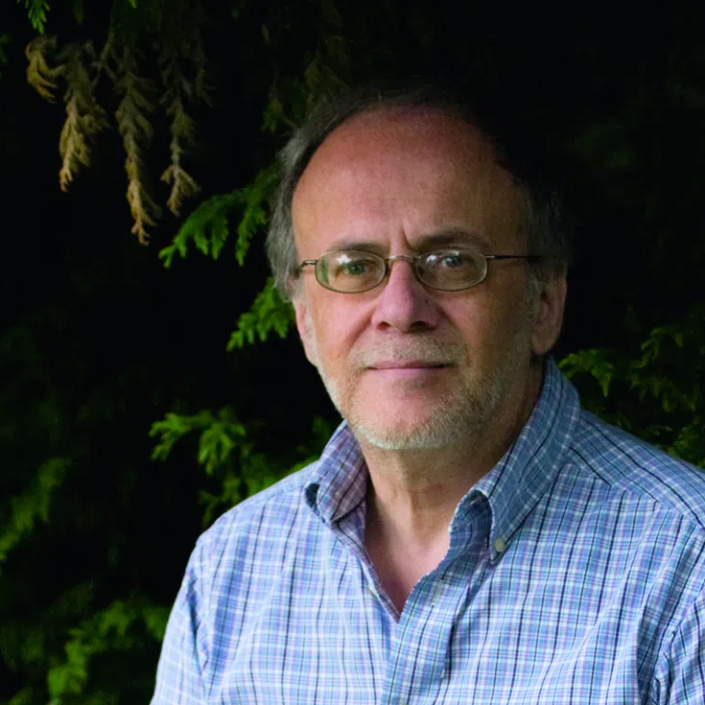
“﻿Papias assumes that the value of oral traditions depends on their derivation from still living witnesses”
RICHARD BAUCKHAM ﻿Jesus and the Eyewitnesses (page 28)

Slide 41
“That which was from the beginning, which we have heard, which we have seen with our own eyes, which we have gazed upon and touched with our own hands—this is the Word of life.”
1 John 1:1

Slide 42
Document the claims of 1 Corinthians 15:1-8 regarding the resurrection account sources
3

Slide 43
“those who were healed … were always present,
not merely when the Savior … some of them survived even to our own times”
QUADRATUS OF ATHENS Ecclesiastical History 4.3.2 Writing in 117 CE

Slide 44
Healing Beneficiaries
Beneficiary | Mark | Matthew | Luke
Jairus
Bartimaeus
… son of Timaeus
5:22
9:18
(unnamed)
8:41
10:46
20:30 (unnamed)
18:35 (unnamed)
10:46

Slide 45
Number of Names
Count of names in the same story told in multiple accounts (excluding major characters and famous people)

Slide 46
Document how the Twelve defended the resurrection
4

Slide 47
Key Takeaways
1
Gospels are ancient biographies which expected living eyewitnesses
2
The New Testament valued living eyewitness sources (and named them)
3
The early church valued living eyewitness sources (and could name them)

Slide 48
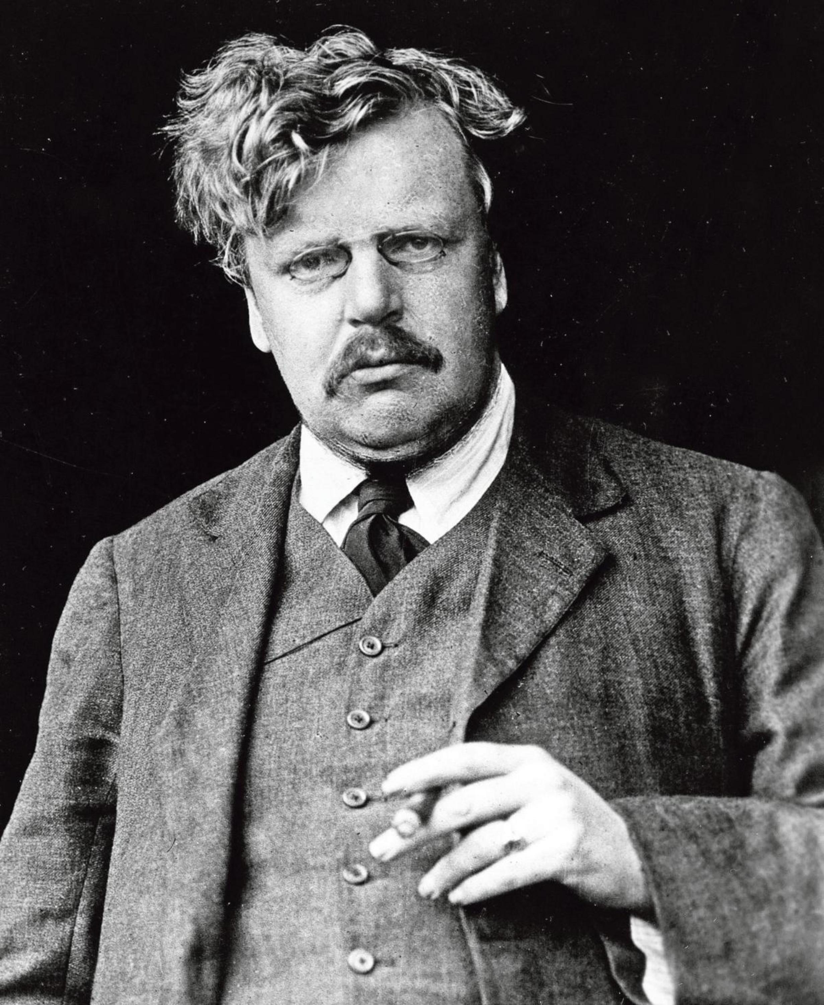
“This is the sort of truth that is hard to explain because it is a fact; but it is a fact to which we can call witnesses”
G.K. CHESTERTON The Everlasting Man

